Slide 1
Governing for Innovation: Creating the Right Board Mix
By Armando “Butz” Bartolome

Slide 2
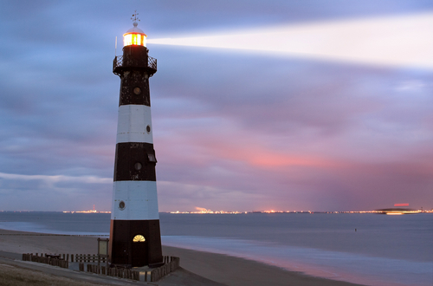
Board as a Beacon
Who Believe and Share in the
Same Advocacy
The common denominator must be one of common interest, ideals and goals

Slide 3
BOARD : Discerning
Ideal Board is one where everybody DISCERNS and not merely A…MEN….
Discussions on the surface and not on below the belt;
Board bullying is a no no

Slide 4
BOARD : INNOVATIONS
Innovations and not merely photocopying :
what can be the best and suitable
in the present time

Slide 5
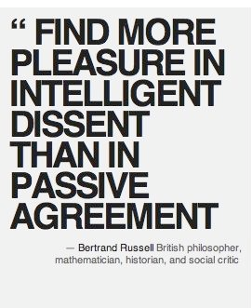
BOARD : Dissent
Dissent is healthy provided it leads a new focus

